Slide 1
design patterns

Slide 2
design patterns
data binding

Slide 3
2 way data binding
data binding

Slide 4
Object
Dependent object
data binding

Slide 5
Object
Dependent object
data binding

Slide 6
Object
Dependent object
data binding

Slide 7
1 way data binding
data binding

Slide 8
Object
Dependent object
data binding

Slide 9
Object
Dependent object
data binding

Slide 10
Object
Dependent object
data binding

Slide 11
design patterns

Slide 12
mvc

Slide 13
model – view – controller

Slide 14
mvc | entities
mvc

Slide 15
Model
mvc

Slide 16
Model
View
mvc

Slide 17
Model
View
User
mvc

Slide 18
Model
View
Controller
User
mvc

Slide 19
mvc | relations
mvc

Slide 20
Model
View
Controller
User
mvc

Slide 21
Model
View
Controller
visible
interacts
User
mvc

Slide 22
Model
manipulates
View
Controller
visible
interacts
User
mvc

Slide 23
Model
updates
manipulates
View
Controller
visible
interacts
User
mvc

Slide 24
mvc | example
mvc

Slide 25
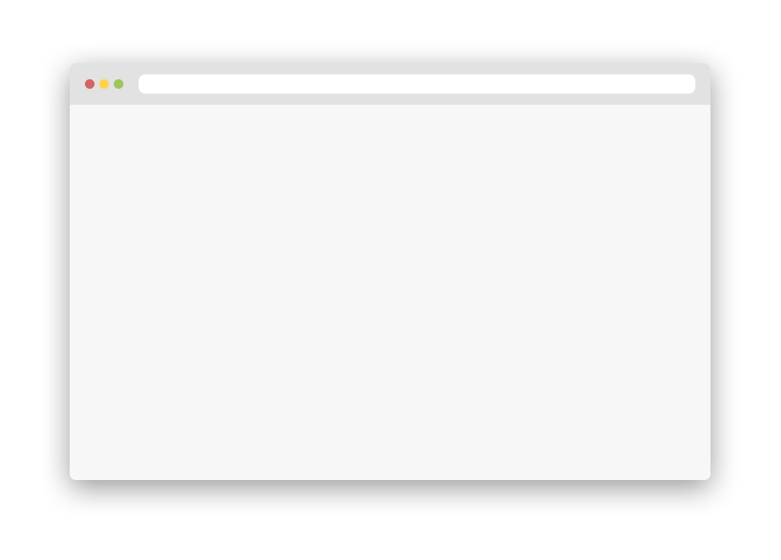
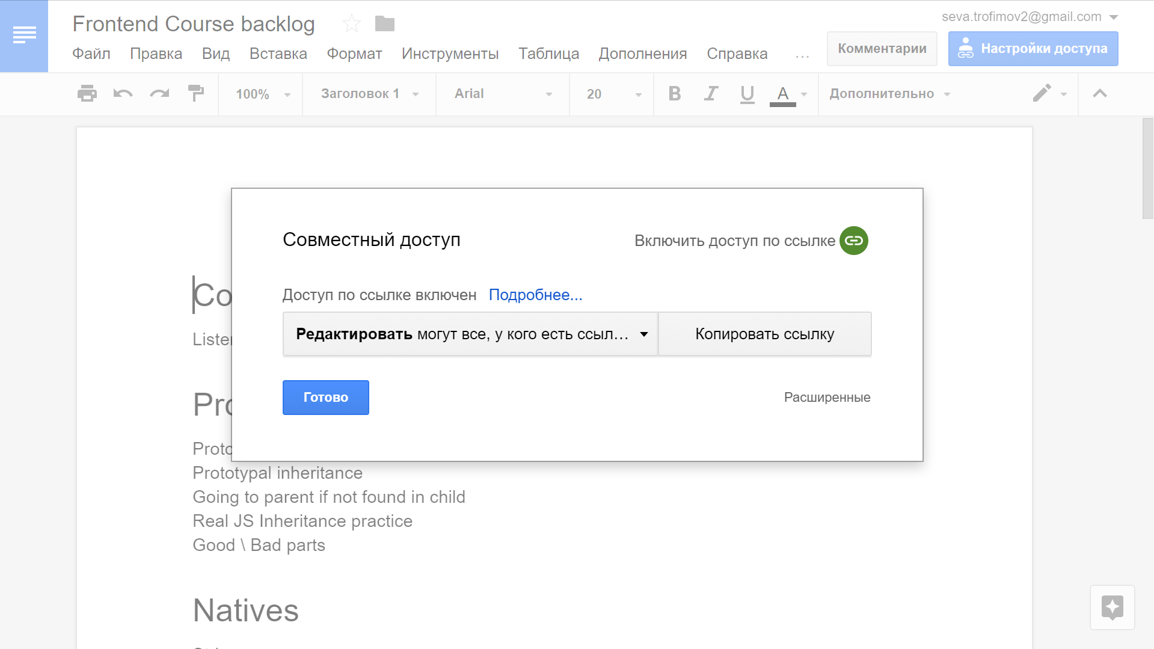
mvc

Slide 26
mvc

Slide 27
mvc

Slide 28
controller -> model.share.changePermissions('edit')
mvc

Slide 29
model -> views.shareModal.permissions.text(shareEditText)
mvc

Slide 30
model -> views.shareModal.status.icon.color('green')
mvc

Slide 31
mvc | good
mvc

Slide 32
Model
updates
manipulates
View
Controller
visible
interacts
User
mvc

Slide 33
Model
updates
manipulates
View
2
3
Controller
visible
interacts
User
mvc

Slide 34
mvc | bad
mvc

Slide 35
Model
updates
manipulates
THE SAME
View
Controller
visible
interacts
User
mvc

Slide 36
Model
KNOWS?
KNOWS?
updates
manipulates
View
Controller
visible
interacts
User
mvc

Slide 37
GETTING DATA FROM
ANOTHER CONTROLLER
Model
updates
manipulates
View
Controller
visible
interacts
User
mvc

Slide 38
mvvm

Slide 39
model – view – view model
mvvm

Slide 40
mvvm | entities
mvvm

Slide 41
Model
mvvm

Slide 42
Model
View
mvvm

Slide 43
Model
View Model
View
mvvm

Slide 44
mvvm | relations
mvvm

Slide 45
Model
View Model
View
mvvm

Slide 46
Model
View Model
View
2 way
data binding
mvvm

Slide 47
Model
View Model
View
2 way
data binding
events
mvvm

Slide 48
Model
View Model
View
2 way
data binding
updates
events
mvvm

Slide 49
Model
View Model
View
changes
2 way
data binding
updates
events
mvvm

Slide 50
mvvm | example
mvvm

Slide 51
mvc

Slide 52
mvc

Slide 53
mvc

Slide 54
bind -> viewModel.share.permissions = 'edit'
mvc

Slide 55
computed & bind -> views.shareModal.status.icon.color = 'green'
mvc

Slide 56
viewModel -> model.share.changePermissions('edit')
mvc

Slide 57
mvvm | good
mvvm

Slide 58
Model
View Model
View
changes
2 way
data binding
updates
events
mvvm

Slide 59
Model
SYNC
View Model
SYNC
View
changes
2 way
data binding
updates
events
mvvm

Slide 60
mvvm | bad
mvvm

Slide 61
Model
View Model
NOT NATIVE
View
changes
2 way
data binding
updates
events
mvvm

Slide 62
Model
Hierarchy
View Model
View
changes
2 way
data binding
updates
events
mvvm

Slide 63
flux

Slide 64
Action
Dispatcher
Store
View
flux

Slide 65
flux | entities
flux

Slide 66
Action
flux

Slide 67
{
type: "TODO_ADD",
value: "Understand flux",
labels: []
}
flux

Slide 68
Action
flux

Slide 69
Action
Dispatcher
flux

Slide 70
Action
Dispatcher
Store
flux

Slide 71
Action
Dispatcher
Store
View
flux

Slide 72
Action
Dispatcher
Store
View
Controller
flux

Slide 73
Action
Dispatcher
Store
View
flux

Slide 74
flux | relations
flux

Slide 75
Action
Dispatcher
Store
View
flux

Slide 76
Action
Dispatcher
Store
View
flux

Slide 77
Action
Dispatcher
Store
View
flux

Slide 78
Dispatcher
Store
Action
View
flux

Slide 79
Store
Dispatcher
Action
View
Store
flux

Slide 80
Store
Dispatcher
Action
View
Store
flux

Slide 81
Store
Action
Dispatcher
Action
View
Store
flux

Slide 82
Action
Dispatcher
Store
View
flux

Slide 83
Action
Dispatcher
Store
View
flux

Slide 84
I have changed
Action
Dispatcher
Store
View
flux

Slide 85
Dispatcher
Store
View
Action
Store
View
Store
View
flux

Slide 86
Dispatcher
Store
View
Action
View
Store
View
flux

Slide 87
Action
Dispatcher
Store
View
flux

Slide 88
Action
Action
Dispatcher
Store
View
flux

Slide 89
flux | example
flux

Slide 90
mvc

Slide 91
mvc

Slide 92
mvc

Slide 93
dispatch({type: "SHARE_PERMISSIONS_CHANGE", value: "edit"})
mvc

Slide 94
dispatcher -> [cb()] -> store.update(action)
mvc

Slide 95
store -> server
mvc

Slide 96
store -> [cb(store.state)] -> view.update(store.state)
mvc

Slide 97
flux | good
flux

Slide 98
Action
Action
Dispatcher
Store
View
Data
Reactions
flux

Slide 99
Action
Action
Dispatcher
Store
View
Data
Reactions
Reactions
Reactions
flux

Slide 100
Action
Dispatcher
Store
View
flux

Slide 101
Dispatcher
Store
View
Action
View
Store
View
flux

Slide 102
Action
Dispatcher
Store
View
Action
View
Action
Store
View
flux

Slide 103
Action
Dispatcher
Store
View
View
Action
Store
View
flux

Slide 104
flux | bad
flux

Slide 105
Action
Action
Dispatcher
Store
View
flux

Slide 106
Action
Action
Dispatcher
Store
FULL UPDATE
View
flux

Slide 107
Action
Action
TYPE COLLISION
Dispatcher
Store
View
flux

Slide 108
flux | practice
flux

Slide 109
Dispatcher
dispatch (action) // notifies subscribers with actions
subscribe (cb) // Adds to subscribers
unsubscribe (???) // removes from subscribers
Store
state
update (action) // mutates or creates new state
subscribe (cb)
unsubscribe (???)
View
update (state) //updates DOM
flux | practice

Slide 110
Action
Action
Dispatcher
Store
View
flux | practice

